Slide 1


A State-level Azadi Ka Amrit Mahotsav Hackathon 2022
Organized By Education Department (Higher & Technical) Government Of Gujarat
Problem Statement : E-challan Payment
Team Leader: Harsh Sonaiya

Slide 2
Problem ID : PID697
Challenge Title : E-challan Payment
Name Of The Office : The Smart City Ahmedabad Development Ltd.
Challenge Description With Context : Out of the total E-challans issued in the current times, only 30-35% are responded to by the citizens. Lacs of challans are generated each day, the manpower limitation leads to issuing of only a thousand of them. This non-issuance of challans causes revenue loss as backdated challans can always be disputed. Therefore, currently only 30% citizens actually end up paying challans that are issued to them. problem to be addressed here is how can the rate of fine payers be increased using a digital solution? Better E-challan collection.
Users : City Traffic Police
Expected Outcomes : Higher collections
Impact : Better traffic law following

Slide 3
Proposed System
E-challan collection system shall provide an alternative way of integrating the E-challan issued to a citizen with a fixed cyclic bill (electricity bill) that the citizen pays without fail.
If one fails to pay challan within the certain time period of 60 days then the challan amount will pass to the Electricity bill and one has to pay the original amount with 30% (60 days) increment in fine.
We reduce the manual work by digitizing the payment of challan online.
Tools and Technology used
Backend
Frontend
Database
Markup Language
IDE
Node Js
CSS
JavaScript jQuery
MySQL
HTML
VS CODE
Software : Windows, macOS
Hardware : Laptop, Desktop

Slide 4
Benefits Of Torrent
Collaboration points where torrent can benefit :-
Higher Revenue Generation.
The government allows open access to the transmission and distribution network, which enables companies like Torrent Power to buy electricity from multiple sources and sell it to their customers.
Government can provide subsidies to Torrent to invest in Solar/Wind power or the government provides subsidies and tax incentives to companies that invest in renewable energy and energy efficiency projects.
Infrastructure Development Schemes : Government can provide grants or funding to invest in infrastructure developments such as power grids, transmission lines.
Benefits Of Our System
Less number of cases of detention as compared to existing system.
Number of violators paying challan would increase.
Less rule breaking due to awareness.
Less manual work required as compared to existing system.

Slide 5
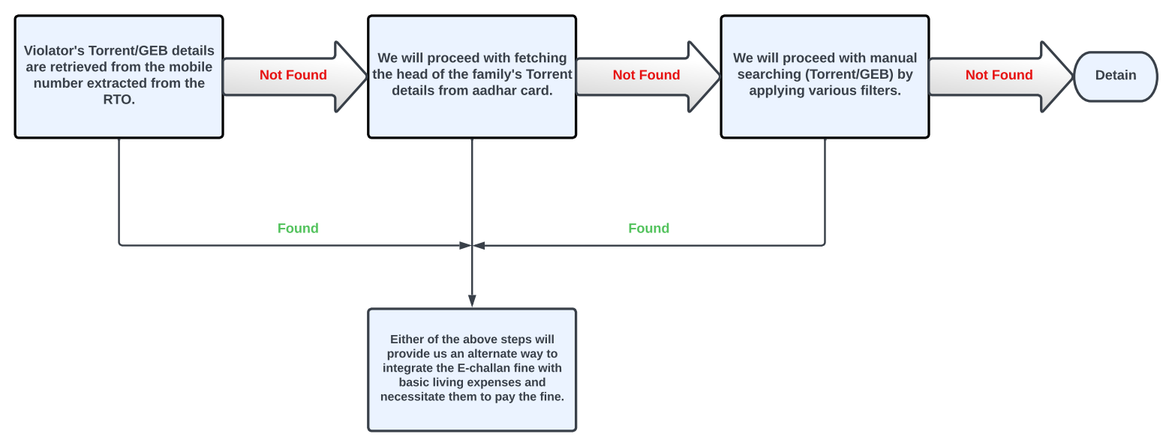
Project at a glance
[Figure No.1 Brief Solution ]

Slide 6
Example
Violator
[Step-1]
Vehicle No.
Mobile No.
Fetched
Bill
OUTCOME

Slide 7
[Step-2]
Violator
Aadhar No.
Fetched
Bill
OUTCOME

Slide 8
Violator
[Step-3]
Manual search
Filter
Fetched
Bill
Outcome
Detain

Slide 9
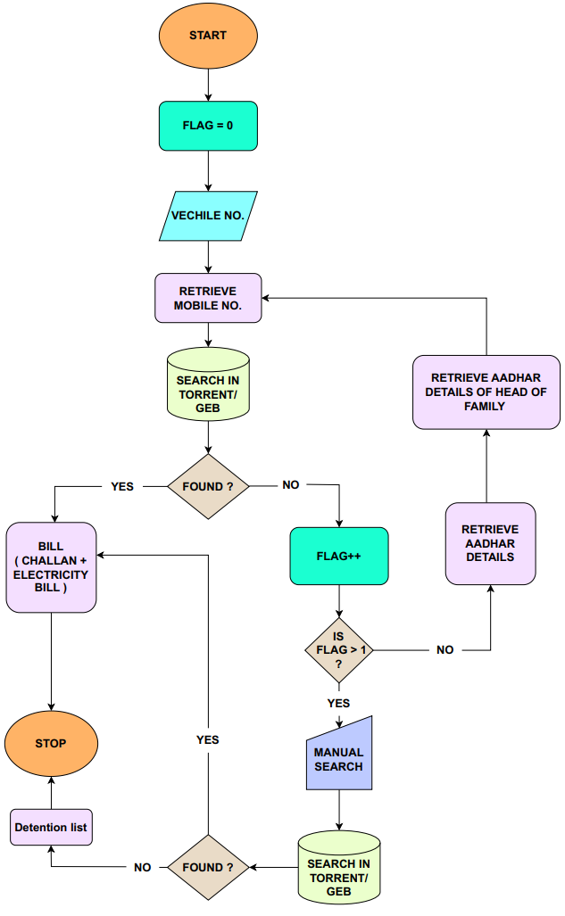
Flow Chart / Road Map
[Figure No.2 Flowchart Of E-challan System ]

Slide 10
Challenges/Risks In Implementing Prototype
Main challenge in our E-challan collection system is the collaboration of government with private sector.
Managing large databases and servers of Government of Gujarat, Torrent Power/GEB and their database management is a big problem for developers.
Depending on the region appropriate body needs to be integrated.
If RTO doesn’t have the updated information it will be a barrier in our system.

Slide 11
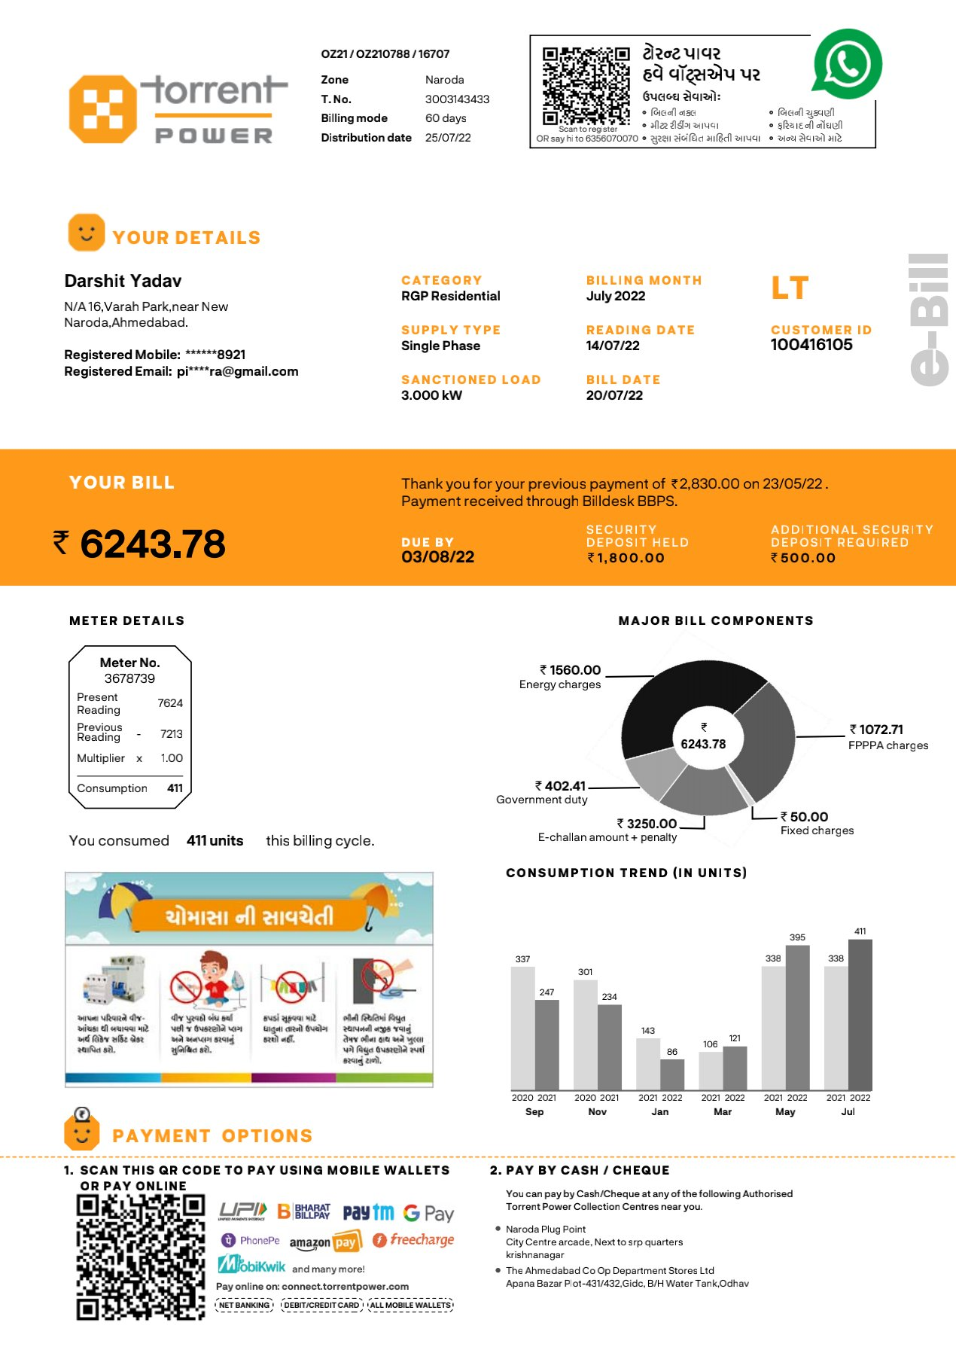
Final Outcome

Slide 12
